Slide 1
0 to 99 Counter

Slide 2

Submitted By
Pankaj Mahanto
ID: 213902002
Mostak Ahamed
ID: 213902126
Rabby Khan
ID: 213902037
Submitted To
Mobasshir Al Rafi
Lecturer, EEE Department
Green University of Bangladesh

Slide 3
Outlines
01
Introduction
Objectives
Equipment's/Tools
Implementation
Result/Output
Limitation
Future Work
Conclusion

Slide 4
Introduction
02
The 0 to 99 Digital Pulse Counter Circuit is an electronic project designed to count and display numbers from 0 to 99 using a breadboard. The circuit utilizes commonly avail-able components such as a 555 timer IC, a 4026 IC, a common cathode 7 segment dis-play, push buttons, resistors, capacitors, and connectors. By combining these elements, the project aims to provide a simple and effective method of counting and displaying numerical values

Slide 5
Objectives
03
Accuracy: Ensure accurate counting and display of numbers from 0 to 99.
Reliability: Design a circuit that operates consistently and reliably over extended periods of use.
User-Friendly Interface: Create a user-friendly interface that allows easy control of the count direction.
Speed and Efficiency: Aim for efficient counting and display operations with minimal delay.
Leveraging unique characteristics.

Slide 6
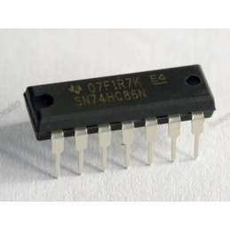
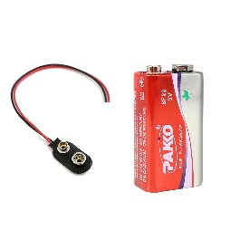
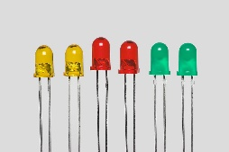
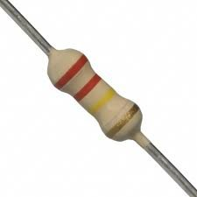
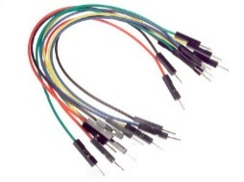
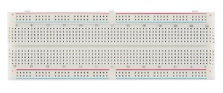
Equipment's/Tools
04
555 timer IC
Bread Board
4026 IC
Common cathode 7 segment display
Two- push ON, push OFF button
Resistors – 10k (3), 100k
Capacitor 1uF, 22uF
Connectors

Slide 7
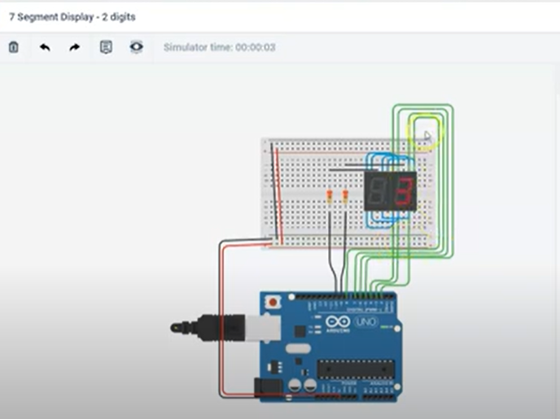
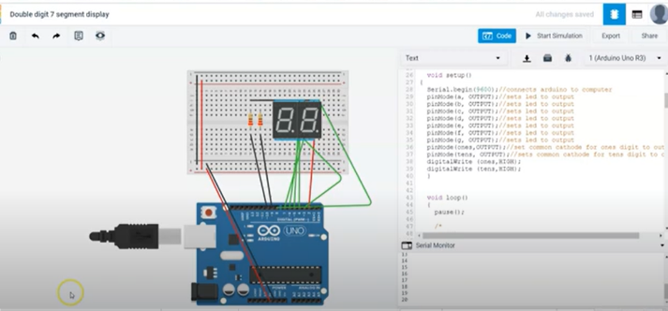
Implementation
05
Using Tinker Cad
Figure-:With running
Figure-:Without running

Slide 8
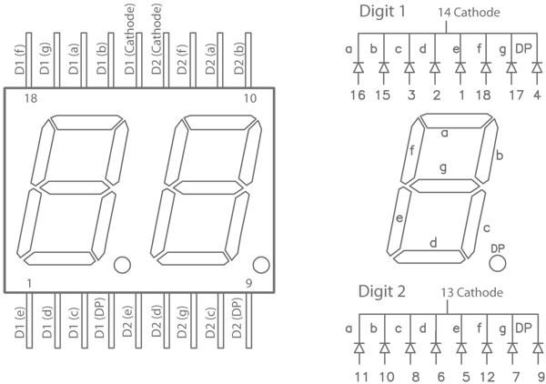
Implementation
06
Circuit Diagram
Figure-:Logic Design 7 segment Display

Slide 9
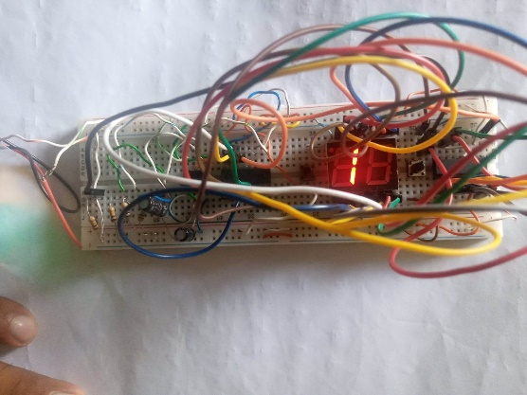
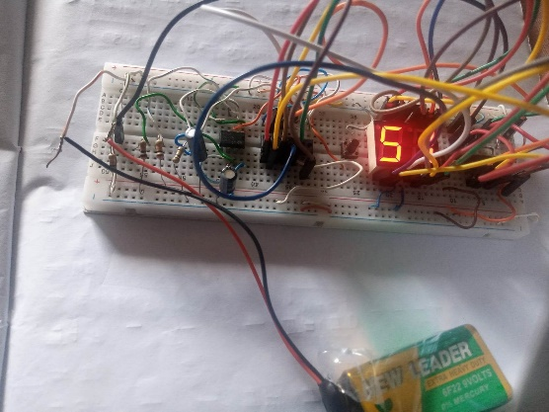
Implementation
07
Using Breadboard
To achieve our objective, we have implemented the 0 to 99 counter on a breadboard, allowing for a physical demonstration of the conversion process. This hands-on approach provides a tangible understanding of the circuitry
Figure-:Count Digit 1
Figure-:Count Digit 5

Slide 10


Result and Output
08
Figure-: Count Digit 1
Figure-: Count Digit 5

Slide 11
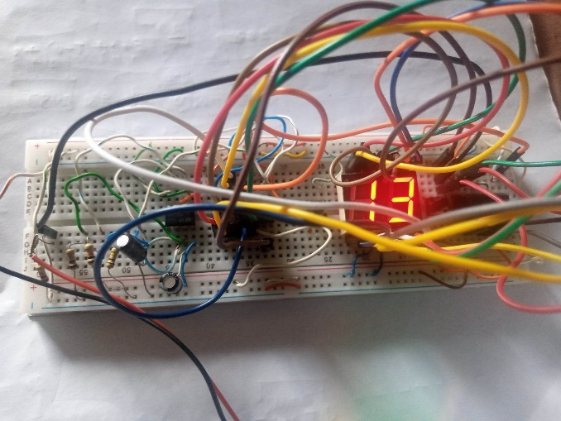
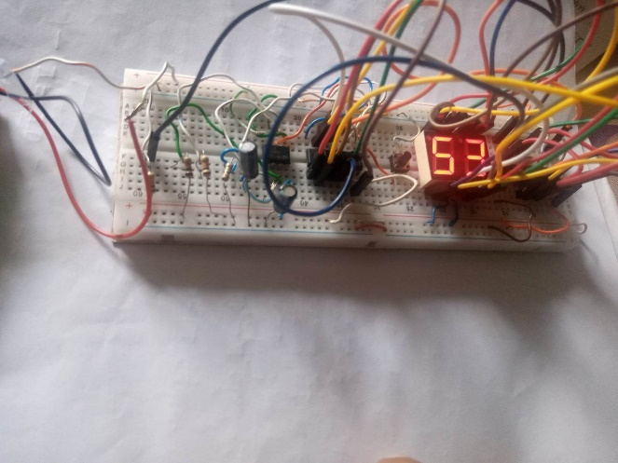
Result and Output
08
Figure-: Count 2 Digit 53
Figure-: Count 2 Digit 13

Slide 12

Limitation
09
Limited Range
Hardware Limitations
Manual Circuit Connections
Single Display
Do not auto update

Slide 13

Future Works
10
Automated Counting: Integrate a microcontroller or programmable logic to auto-mate the counting operation based on external triggers or timing conditions.
Multiplexed Display: Implement multiplexing techniques to support multiple 7-segment displays, allowing for the simultaneous display of multiple counts or additional visual information.
Advanced User Interface: Incorporate a more intuitive and user-friendly interface,such as using a keypad or touchscreen display for count control and input.
Data Logging and Analysis: Add the capability to log count data and perform anal-ysis, such as tracking count frequencies or generating statistical reports.

Slide 14
Conclusion
11
The 0 to 99 Digital Pulse Counter Circuit project provides a functional solution for counting and displaying numbers using a breadboard and various electronic components. The implementation of the circuit, it allows users to manually control the counting direction and observe the count value on the 7-segment display.The project's discussion highlights the successful design and development of the circuit, addressing the challenges associated with component integration, circuit complexity, and accuracy. It emphasizes the importance of proper wiring, component selection, and logical implementation to achieve the desired functionality.

Slide 15


Slide 16


